Slide 1
Scratch Detection

Slide 2
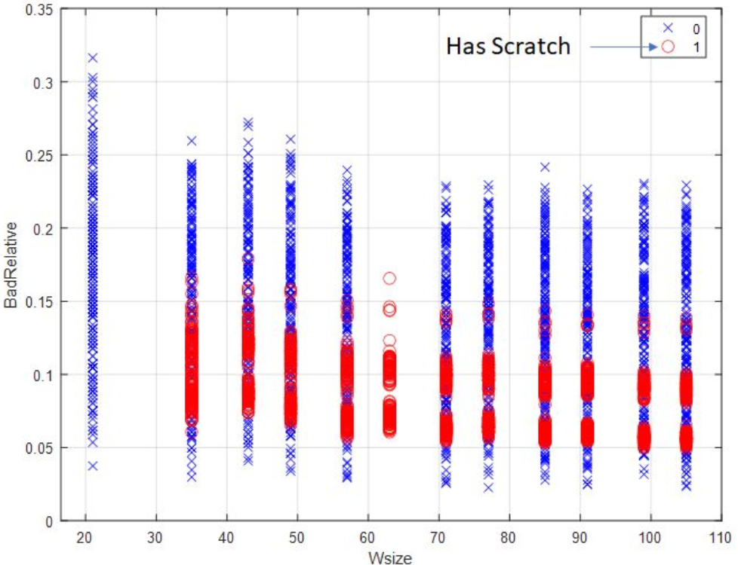


Filter Wafers
Filter by Wafer size, by three ranges conditions:
Less than 35: No scratches
35<->63:
Line: -0.001*wafer_size+0.19:
If above the line no scratches.
If below the line, there is scratches.
63<->infinity
Line:-0.0003* wafer_size+0.13
If above the line no scratches.
If below the line, there is scratches.
$$\frac{Bad dies}{Total dies}$$
$$Wafer size$$

Slide 3


Flow:
Train
Test
Filter Wafers
Train Wafers number: 3920
Hyper-parameters search
Two parameters:
Polynomial order: Order of the polynomial fit to the scratch
The ink pixels strength weight: penalized on the model score for including good dies.
Three values considered for each: total of 9 combination tested
The model (described later) was
applied to each combination
Scratch prediction
Predictions on the test set:
Filter by Wafers size
With the best parameters (F1 score=48%) from last the Hyper-parameter search (Polynomial order=3. Ink pixels strength weight =-0.5)
$$Filter by$$
$$Wafer size$$
Wafers number: 2372
$$long running time$$
$$(\sim 1.5 hours per run)$$
Wafers selected: 1000

Slide 4
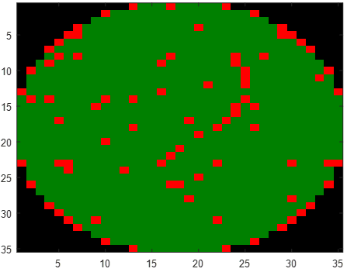
Model for scratch detection:
Wafer: 97a213

Slide 5
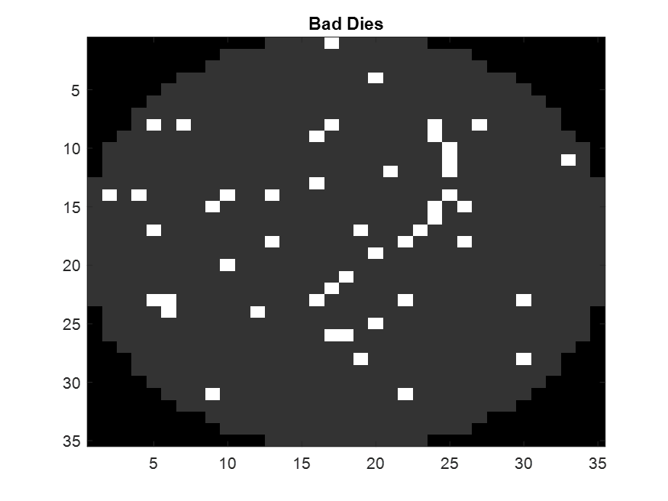
Connected Components of Bad Dies
and filter out segment below given threshold (=3)
Bad Dies
Segments with area >= 3
4
Connected
Components
CC #1
2
3

Slide 6
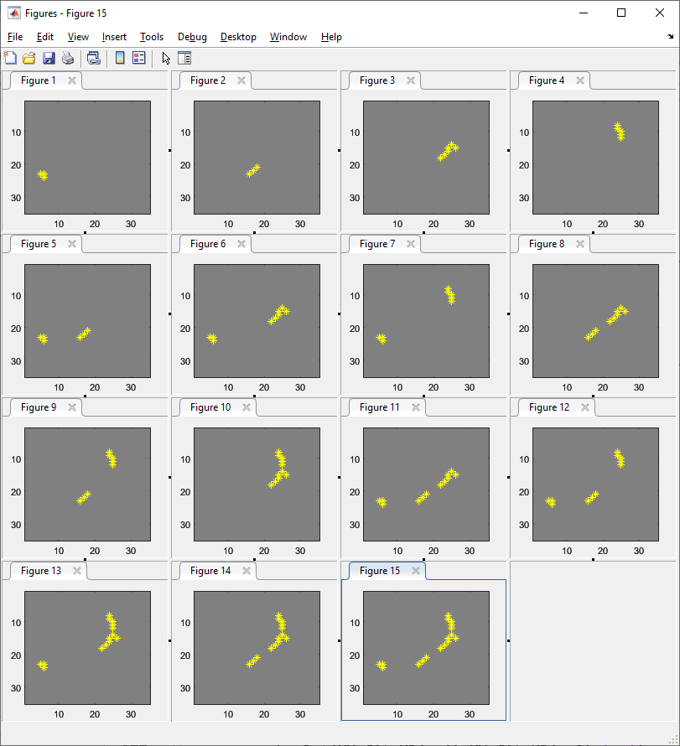
All possible combinations
No. | Score
1 | 0.040
2 | 4.049
3 | 6.046
4 | 5.681
5 | 4.037
6 | 6.966
7 | 0.180
[1] [2] [3] [4]
4
[1 2] [1 3] [1 4] [2 3]
1
2
3
8 | 11.903
9 | 10.407
10 | 11.041
11 | 8.600
12 | 2.704
13 | 4.3906
14 | 15.882
15 | 3.5259
[2 4] [3 4] [1 2 3] [1 2 4]
[1 3 4] [2 3 4] [1 2 3 4]
Best
score

Slide 7
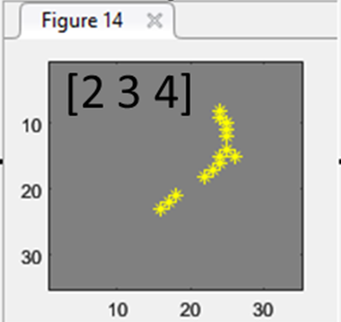
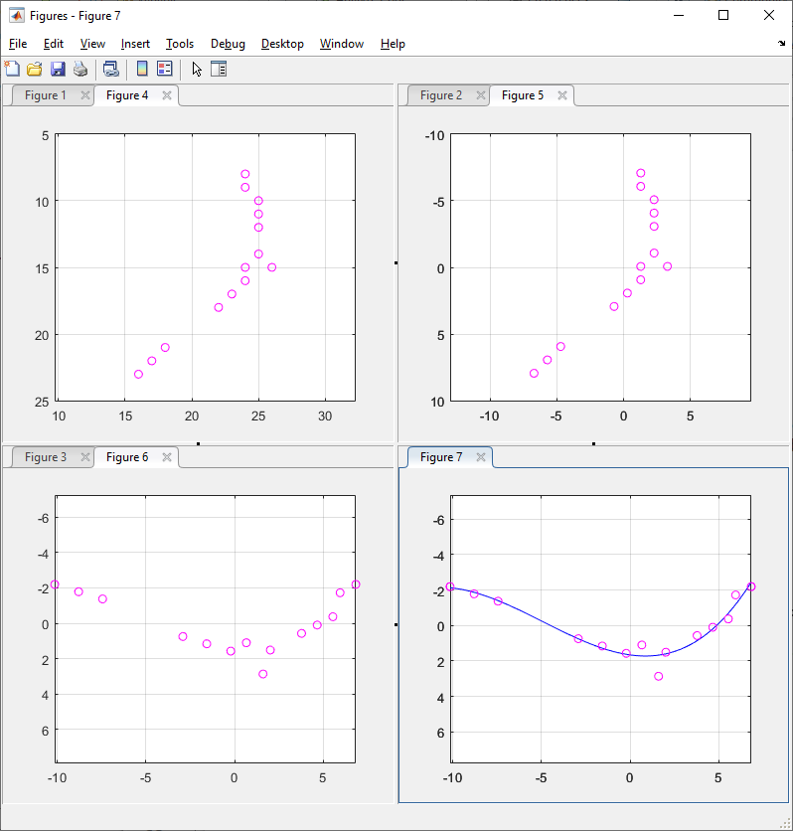
Fitting the points
Original points
Centralized to (0,0)
(no_points = 14)
Combination #14
Rotated to horizontal
orientation
Polynomial fit (order 3)

Slide 8
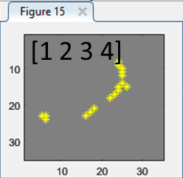
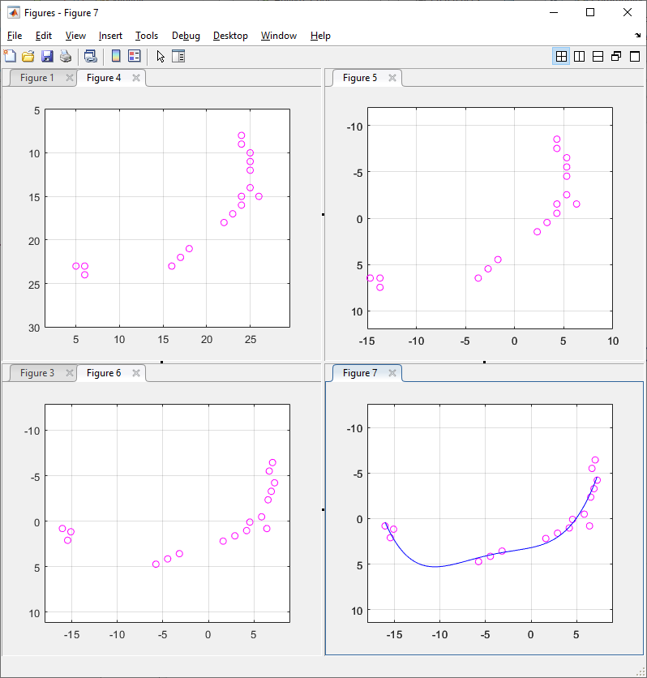
Fitting the points
Original points
Centralized to (0,0)
(no_points = 17)
Combination #15
Rotated to horizontal
orientation
Polynomial fit (order 3)

Slide 9
Score Calculation
Combination #14
Zoom
Slend_score
1
L
W
0.01
0.5
Slend_ratio
Fit_score = e0.1 [ (# bad_dies) – 0.5*(# good_dies) ]
= e^{0.1 [14 – 0.5*12]} = e^{0.8}
= 2.2255
Slend_ratio = W / L = 4.17 / 17 = 0.245
Slender_score = min(-2*Slend_ratio + 1, 0.01)
= 0.5098
Final_score = Fit_score * Slender_score * no_points = 2.2255 * 0.5098 * 14 = 15.88

Slide 10
Score Calculation
Combination #15
Zoom
L
W
Ink pixels strength weight = -0.5
Fit_score = e0.1 [ (# bad_dies) – 0.5*(# good_dies) ]
= e^{0.1 [10 – 0.5*25]} = e^{-2.5}
= 0.7788
Slend_ratio = W / L = 8.547 / 23.3 = 0.3668
Slender_score = min(-2*Slend_ratio + 1, 0.01)
= 0.2664
Final_score = Fit_score * Slender_score * no_points = 0.7788 * 0.2664 * 17 = 3.53

Slide 11
Final Detection
Combination #14 gives the best score

